Slide 1
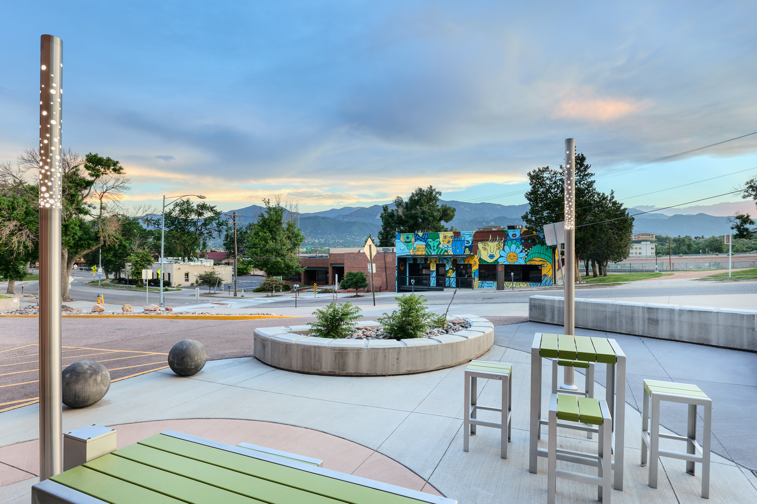
Higher Learning Commission (HLC)
Reaffirmation of Accreditation Visit
Town Hall
10-29-24
Dr. Deborah Licht
Special Assistant to the
Vice President for Instructional Services
Dr. Patricia Grandieu
Executive Director of Institutional Effectiveness

Slide 2
Why is regional accreditation important?

Slide 3
Why is regional accreditation important?
  Access to Federal Funding: makes education more accessible to students.
  Recognized Degrees: enhanced student’s employability.
  Transferability of Credits: credits earned at accredited institutions are more likely to be accepted by other institutions.
  Community Recognition: enhanced reputation and support from local partners.
  Quality Assurance: evidence that institution meets rigorous educational standards.
  Continuous improvement: accreditation process encourages institutions to engage in self-assessment and continuous improvement efforts.

Slide 4
Guiding Values
Through peer review approach, HLC ensures that institutions meet specific standards of quality in education, governance, and institutional effectiveness.
Standards of quality are grounded in the following Guiding Values
  Focus on student learning
  Education as a public purpose
  Education for a diverse, technological, globally connected world
  A culture of continuous improvement
  Evidence-based institutional learning and self-presentation
  Integrity, transparency, and ethical behavior or practice
  Governance for the well-being of the institution
  Planning and management of resources to ensure institutional sustainability
  Mission-centered evaluation
PPSC Mission: To provide high-quality educational opportunities to all students, with a focus on student success and community needs
PPSC Vision: Students succeed at PPSC

Slide 5
Criteria for Accreditation
Criteria for Accreditation are “the standards of quality by which HLC determines whether an institution merits accreditation or reaffirmation of accreditation.” (HLC, 2020)
Criterion 1. Mission: The institution’s mission is clear and articulated publicly; it guides the institution’s operations.
Criterion 2. Integrity: Ethical and Responsible Conduct: The institution acts with integrity; its conduct is ethical and responsible.
Criterion 3. Teaching and Learning: Quality, Resources, and Support: The institution provides quality education, wherever and however its offerings are delivered.
Criterion 4. Teaching and Learning: Evaluation and Improvement: The institution demonstrates responsibility for the quality of its educational programs, learning environments, and support services, and it evaluates their effectiveness for student learning through processes designed to promote continuous improvement.
Criterion 5. Institutional Effectiveness, Resources and Planning: The institution’s resources, structures, and processes are sufficient to fulfill its mission, improve the quality of its educational offerings, and respond to future challenges and opportunities.

Slide 6
Accreditation Cycle (2015 – 2025)
 | 2015 | 2016 | 2017 | 2018 | 2019 | 2020 | 2021 | 2022 | 2023 | 2024 | 2025
On-site Visit | Comprehensive Evaluation Visit |  | Multi-location Visit |  |  |  |  |  | Multi-location Visit |  | Comprehensive Evaluation Visit
Virtual Review |  |  |  |  | Assurance Review (Assurance Argument + Evidence File) |  | Quality Initiative

Slide 7
Quality Initiative: Becoming a Hispanic Serving Institution to Better Serve Hispanic-Identifying Students
  The HLC Review Panel confirmed PPSC’s commitment to its Quality Initiative:
    Pikes Peak State College has demonstrated a profound commitment to becoming a Hispanic-Serving Institution through strategic initiatives, substantial resource allocation, and comprehensive engagement across the college community.
    The institution’s efforts reflect a deep dedication to fostering an inclusive environment that supports the academic and personal success of Hispanic/Latine students.
    As PPSC continues to build on this progress, it is well-positioned to achieve and maintain its HSI designation, further enhancing its mission to provide equitable and accessible education for all students.

Slide 8
Comprehensive Evaluation Visit (April 14-15, 2025)
Verify compliance with HLC criteria
Includes an on-site visit by a peer review team to verify that the claims made by the institution in its submitted materials are accurate.
Areas of emphasis:
  Accuracy of information (e.g., website, catalog, syllabus)
  Alignment between operations and mission/strategic priorities
  Program review and assessment (commitment to continuous improvement)
  Faculty/instructors credentialing (review of randomly selected HR files during the visit)
  Online education (especially Regular and Substantive Interaction)
  Ethical and responsible conduct (e.g., use of AI and recruitment/admission practices)

Slide 9
Preparing and Hosting the “Comp” visit
1.
Federal Compliance
2.
Assurance Argument
3.
Mock Visit
4.
Student Opinion Survey
5.
On-site Visit

Slide 10

1. Federal Compliance
Purpose: Verify compliance with federal regulations
Section | Lead | PPSC Reviewers
1. Assignment of Credits, Program Length and Tuition | Deb Licht | Executive Deans, Stephanie Snyder, Rose Angry
2. Institutional Mechanisms for Handling Student Complaints | Kim Hennessy, Maria Mesa | Nicole Pritchett-Hilliard, Yolanda Harris
3. Publication of Transfer Policies | Maria Mesa | Wayne Artis, Sarah Clay, Brook Koltun
4. Practices for Verification of Student Identity | Deb Licht | Cynthia Krutsinger, Kevin Hudgens, Stephanie Snyder
5. Protection of Student Privacy | Maria Mesa | Stephanie Snyder
6. Publication of Student Outcome Data | Patricia Grandieu | Hannah Newman
7. Standing With State and Other Accreditors | Deb Licht | Executive Deans
8. Recruiting, Admissions and Related Enrollment Practices | Maria Mesa | Kevin Hudgens, Matt Radcliffe, Ron Swartwood

Slide 11
2. Assurance Argument
In progress: narrative + evidentiary documents supporting claims made in the narrative
Writing Teams
  Criterion 1: Jim Mancall and Enrique Romo
  Criterion 2: Kim Hennessy and Deb Licht
  Criterion 3: Deb Licht, Maria Mesa, and Darlene Melby
  Criterion 4: Deb Licht and Patricia Grandieu
  Criterion 5: Darlene Melby, Jim Mancall, and Patricia Grandieu
Timeline:
  Early December to early January: Review
  By mid-January: Incorporate feedback + upload narrative and evidence files into Assurance System
  January 17: Lock date for mock visit
  March 17: Lock date for actual HLC visit

Slide 12
3. Mock Visit, February 17 & 18
Objective: prepare PPSC for the actual visit
Three experienced HLC reviewers:
  Janna Oakes (CO), Jennifer Miller (Iowa), and Tristan Londre (Missouri)
Within 10 days of the mock visit, PPSC will receive
  feedback regarding the draft Assurance Argument and quality of evidence
  an assessment of the preparedness of the PPSC community
  recommendations for improvement (if any)

Slide 13
4. Student Opinion Survey
Mid-February, PPSC will share the survey link with all students. A reminder email will be sent at least four days later. The survey will remain open for 10 days.
Purpose: Allow all students, rather than just students who happen to be on campus at the time of a visit, to voice opinions on questions important to them.
Results are intended to help the peer review team identify possible questions for its meetings with faculty, staff and students during the visit.
15 close-ended questions + one open-ended question for comments
  enrollment process, cost of attendance, financial aid, academic advising, availability of courses, quality of instruction, support services, overall satisfaction

Slide 14
5. Actual On-site Visit, April 14 & 15
Purpose: verify accuracy of narrative, collect additional information/evidence, make recommendations on reaffirmation of accreditation to the Institutional Actions Council (IAC)
Review Team
Name | Title | Institution
Randall Fletcher | VP of Academic & Student Affairs | Eastern Florida State College, FL
Kaylyn Bondy | VP for Student Affairs, Title IX Coordinator | Bismarck State College, ND
Gene Kramer | Professor | University of Cincinnati Blue Ash College, OH
Ronna Vanderslice | VP for Academic Affairs | Oklahoma State University Institute of Technology-Okmulgee, OK
Courtney Bruch | Director of Assessment and Accreditation | Northern New Mexico College, NM
Before the visit:
  Phone meetings to share first impressions + identify strengths and possible gaps + ask for clarification/additional evidence (if needed)
  Two reviewers assigned to each criterion
  Entire team expected to read materials: Assurance Argument + student opinion survey results + federal compliance report + as many evidence files as possible
  Each reviewer crafts questions for their assigned criteria
  Review Team meets the day before the visit

Slide 15
Example of Visit Schedule
Monday
8:30 - 9:45 am | Meeting with President and Campus Tour
9:50 - 10:40 am | Meeting with Executive Team
10:45 - 11:15 am | Meeting with Assurance Process Team
11:20 am - 12:10 pm | Open Forum – Criterion 1
12:15 - 1:00 pm | Lunch Break
1:00 - 1:50 pm | Open Forum - Criterion 2
2:00 - 2:50 pm | Open Forum - Criterion 3
3:00 - 3:50 pm | Open Forum - Criterion 4
4:00 - 4:50 pm | Meeting with Students
Tuesday (morning)
9:00 - 9:50 am | Open Forum - Criterion 5
 | Faculty Qualifications Review (with HR)
10:00 - 10:50 am | Special Focus Forum - Topic 1
 | special Focus forum - Topic 2
11:00 - 11:40 am | Review Team meeting
11:45 am - noon | Exit meeting with President / Executive team

Slide 16
Review Team’s Recommendations and HLC Decision on Reaffirmation of Accreditation
Tuesday afternoon and Wednesday: Review Team meets to write feedback and agree on recommendations (met, met with concerns, not met)
Within a month of the visit (end of May), PPSC will receive a draft report and have an opportunity to correct any errors of fact (institutional response).
HLC decision-making body (IAC) will make a decision based on institution's response to the team's recommendations, along with the recommendations themselves.
    Reaffirmation of accreditation: all 18 core components are “Met”
    Monitoring: one or more core component rated as “Met with concerns”
    Sanctions: one or more core component rated as “Not met”
Institutional Actions Council Meetings: June 30 - July 1, August 11 - 12, September 29 - 30

Slide 17
What is my role in the reaffirmation of accreditation process?

Slide 18
How you can contribute (1)
Update Communication Materials
  Review and refresh webpages, catalog pages, print materials (logo, url, contact info,…), handbooks, portal pages,…
Use survey results (especially CCSSE, CCFSSE, CCCS Belonging survey)
  Review and discuss findings
  Identify strengths and opportunities for improvement
  Develop action plans and implement strategies for improvement
Stay informed about current initiatives and accomplishments
  Watch Dr. Bolton’s weekly video updates
  + press releases, townhalls
Respond to information requests: tell your story!
  Gather and provide evidence that supports the Assurance Argument narrative
    Focus: effectiveness and commitment to continuous improvement, beyond description of services/programs

Slide 19
Examples of Evidence
Criterion 3. Teaching and Learning: Quality, Resources, and Support: The institution provides quality education, wherever and however its offerings are delivered.
3.C. The institution has the faculty and staff needed for effective, high-quality programs and student services.
PPSC’s Mission statement
BPs / SPs - Personnel (including evaluation of performance)
IPEDS Human Resources survey (number of employees)
Student-to-faculty ratio
Survey results and use of results (e.g., CCSSE, satisfaction surveys, end-of-term evaluations of instruction)
Job descriptions (minimum qualifications)
Orientation/onboarding programs
Documentation of professional development and training opportunities for staff and faculty (Handbooks + training materials + agendas)
Program review/evaluation process, findings and use of results
Budget reports (e.g., resources allocated to new positions or professional development)
What is not documented does not exist!

Slide 20
How you can contribute (2)
Provide feedback on the draft Assurance Argument (December – January)
Attend Spring PDW HLC workshops
    HLC and Comprehensive Evaluation Overview
    Criteria 1, 2 and 5
    Criteria 3 & 4
Participate in the mock visit (February 17 & 18)
Attend mock Open Forum meetings (March)
    Practice “elevator speech”
    Practice answering questions
Participate in the actual on-site visit (April 14 & 15)

Slide 21
PPSC’s HLC Institutional Representatives
Chief Executive Officer (CEO) – Lance Bolton, President
Accreditation Liaison Officer (ALO) – Patricia Grandieu, Executive Director of Institutional Effectiveness
Chief Academic Officer – Jacque’ Gaiters-Jordan, Vice President for Instructional Services
Chief Financial Officer – Darlene Melby, Vice President for Administrative Services (CFO)

Slide 22
Useful Links
PPSC Accreditation Reports: https://www.pikespeak.edu/about/accreditations.php
HLC Guiding Values: https://www.hlcommission.org/accreditation/policies/criteria/guiding-values/
HLC Criteria: https://www.hlcommission.org/accreditation/policies/criteria/2020-criteria/
Comprehensive Evaluation Visit: https://www.hlcommission.org/accreditation/cycles-and-processes/comprehensive-evaluation/comprehensive-evaluation-visit/
Student Opinion Survey: https://www.hlcommission.org/accreditation/cycles-and-processes/comprehensive-evaluation/student-opinion-survey/

Slide 23









HLC 2025 Comprehensive Evaluation Visit Timeline
Starting Now
October 2024: Fall Accreditation Town Hall
January 2025: Spring PDW Accreditation Workshops
Mock Visit: mid-February
March 2025: Spring Accreditation Town Hall
April 14 & 15, 2025: On-Campus Visit
May 2025: Results

Slide 24
Examples of questions
Criterion 1
How do you/your department contribute to the PPSC mission and strategic planning priorities?
Can you describe your department's diversity, equity, and inclusion efforts?
In what ways does PPSC demonstrate its commitment to the public good?
Criterion 2
How are procedures developed and updated at PPSC?
Does PPSC have procedures in place to address ethical conduct in research for both faculty and students?
What examples can you share that illustrate how ethical practices are demonstrated in your department?
Criterion 5
Can you describe the budgeting process?
Can you describe shared governance and how faculty participate in decision-making?
What kinds of changes are taking place within the college/your department?
What challenges do you believe PPSC will need to deal with in the next 10 years?

Slide 25
Examples of questions
Criterion 3
How does PPSC provide support for student learning and effective teaching?
How do you ensure the quality of courses or programs offered via online education? in courses delivered at high school locations?
What is the purpose of PPSC's General Education program?
What evidence do you have that student support services / technology / facilities meet the needs of your students?
Criterion 4
Tell us about your department, division or college's assessment program. How has it changed over recent years?
What improvements have resulted from your program review process/ assessment program?
How are student success outcomes analyzed and shared with faculty, staff and students?

