Slide 1

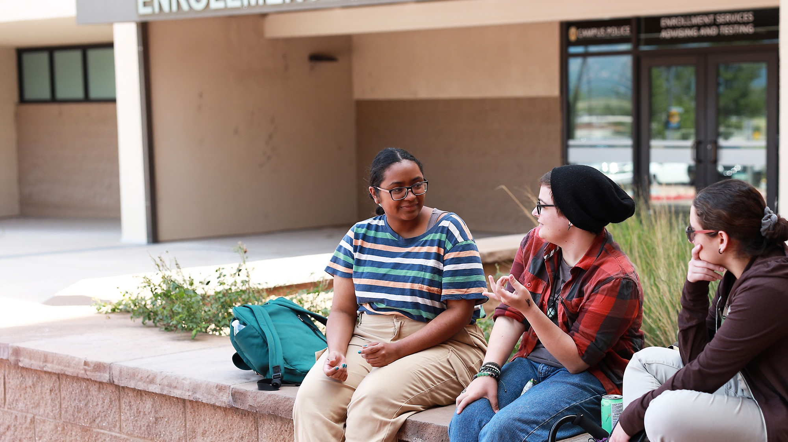


Professional Development Week | President’s Address
PROFESSIONAL DEVELOPMENT WEEK
PRESIDENT’S ADDRESS FALL 2025

Slide 2

Federal Updates

Slide 3

H.R. 1, The “Big Beautiful Bill”
Potential Positives for Community Colleges:
Pell Grant Stabilization: (Effective Oct. 1, 2025) Allocates $10 billion into the Pell Grant program to address projected shortfalls and ensure continued funding.
Workforce Pell Codified: (Effective July 1, 2026) Formally establishes Workforce Pell, expanding Pell eligibility to students enrolled in short-term, workforce-aligned programs (8–15 weeks/150–600 clock hours).
Financial Aid Fairness for Families: (Effective July 1, 2026, for the 2026–27 award year) Excludes the value of family farms, small businesses, and commercial fisheries from being counted as assets when determining financial aid eligibility. Helps rural and asset-rich/cash- poor families..
FAFSA Improvements: (Unknown Effective Date) Includes technical fixes to improve the FAFSA process and better target need-based aid. Though, there are significant concerns about the U.S. Department of Education’s ability to smoothly implement.

Slide 4

H.R. 1, The “Big Beautiful Bill” cont.
Areas we’re paying more attention to:
New Accountability Metric based on students’ earnings: (Effective July 1, 2026) Prohibits the use of federal direct loans for programs categorized as “low-earning outcome undergraduate programs.”
Parent PLUS Loan Caps: (Effective July 1, 2026) Annual limit set at $20,000 per student; lifetime cap of $65,000. May disproportionately affect high-cost four year institutions—but could increase community colleges’ appeal as a more affordable path to a bachelor’s degree.
Student Loan Program Changes: (Effective July 1, 2026): Modifies repayment structures and eligibility, which may affect student decision-making and access to federal borrowing.
Public Assistance Program Changes: Adjustments to SNAP and Medicaid could harm students who rely on public support, potentially affecting retention and completion. New work requirements for Medicaid effective Jan 1, 2027. Federal cuts to SNAP and Medicaid effective Jan 1, 2028.
Loan Caps: (No effective date mentioned) New requirement for colleges to prorate loan caps to the number of credit hours enrolled.

Slide 5

Colorado State Budget Implications
The Governor’s Office of State Planning and Budgeting (OSPB) reports H.R. 1 will:
Reduce Colorado revenues and increase state costs
Likely result in a special legislative session to rebalance the FY 2025-26 budget
Drivers of the State Shortfall:
Tax Code Changes: Revenue losses due to tax policy changes that apply to the 2025 calendar year but that will have to be accounted for in the 2025-26 budget.
SNAP Cost Shifts (Effective Oct. 1, 2027): States now required to contribute to the cost of food benefits in SNAP. Administrative cost share increased from 50% to 75%. Federal Funding cuts to SNAP effective Jan. 1, 2028.
Medicaid Cuts (Effective Jan 1, 2028): The Colorado Department of Health Care Policy and Financing (HCPF) -- which administers Medicaid -- reports the bill would mean a loss of between $900 million and $2.5 billion a year.
Baseline Outlook:
Even without the new federal budget bill, Colorado faces a structural budget deficit, with revenue forecasts anticipating decreases in tax revenue. When revenues fall, especially below the TABOR cap, the state's revenue growth isn't keeping pace with the rising costs and needs of essential services like education, healthcare, and transportation. And the new federal mandates (like covering more SNAP and Medicaid costs) are only going to make that worse. The September Revenue Forecast will provide more clarity on budgets.

Slide 6
Numbers

Slide 7
Enrollment | AFTE
Unduplicated Headcount
AY 23/24 = 17,742 students
AY24/25 = 17,998 students
Difference: +256 students
Fall 2025:
FTE = 8,526.5

Slide 8
Retention

Slide 9
Retention By Ethnicity

Slide 10

Graduation
Degrees & Certificates
3,562 | 20/21
3,051 | 21/22
3,242 | 22/23
3,256 | 23/24
3,207 | 24/25*
*Includes 87 BSN/BAS degrees
PPSC now offers 7 Bachelor’s Degrees
Bachelor of Applied Science
Advanced Paramedic Practitioner
Behavioral Health
Business Administration
Cybersecurity
Emergency Service Administration
Elementary Education (Pending HLC Approval)
Bachelor of Science in Nursing
RN-BSN

Slide 11






Commencement Stats
Students:
663
students walked
6,000+
came in person
2,500+
watched the live stream
Volunteers:
Our Most
Participants Ever!
19
teams
160
volunteers
Other Notable Wins:
The revamped stage design (banners and gonfalons)
and graduate procession created a more sophisticated graduation experience.
Early check-in process at our campuses allowed us to
check in 334 graduates before the ceremony
(50.5% of ceremony participants).
Democratic student speaker selection process yielded
an excellent result through an equitable process.
Notes:
Add Gonfalon Stuff

Slide 12
Achieving HSI Designation

Slide 13

Budget and Reserves

Slide 14
Where Our Money Comes From
$111.6 Million
In Total
Notes:
Add a total

Slide 15
In Person vs Online Tuition Actual Revenue FY25
Resident and Non-Resident
FY26
Every 1% increase in Enrollment increases Tuition Revenue by $1,600,000
(includes 3.5% tuition
increase FY26)

Slide 16
Reserve Balance History

Slide 17


Renovation, Remodel & Refurbish Projects (RRR) Update
ASAP or Under Way:
  All Campuses, Furniture Replacement Phase 1, Ongoing - $800,000
  Rampart Engineering Classrooms, Fall 2025 – $775,000
  Downtown Music Rooms, Working with Architect - $1,600,000
  Total: $3,175,000
Up Next:
  Rampart Health Labs, In Code Review, $1,800,000
  Centennial F Building Remodel, $5,500,000
  Total: $7,100,000
Later, TBD:
  Refurbish PPSC Conference Rooms, $1,200,000
  Centennial, HRS Remodel, $300,000
  Centennial, Grove and Student Experience Remodel, $2,100,000
  Total: $3,600,000
RRR Total: $13,875,000
Notes:
Add a good furniture photo from Jay

Slide 18

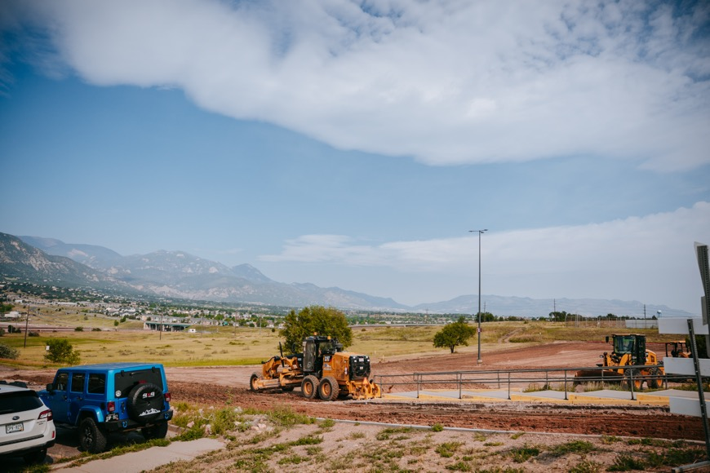
Other Cash-Funded Projects
Fire Training Garage, $1,237,500
Parking Lots, $1,377,750
Wayfinding, $1,300,000
Facilities Master Plan, $300,000
Other Project Total: $4,215,250
RRR Project Total: $13,875,000
Total Investment: $18,090,250

Slide 19
Staffing

Slide 20
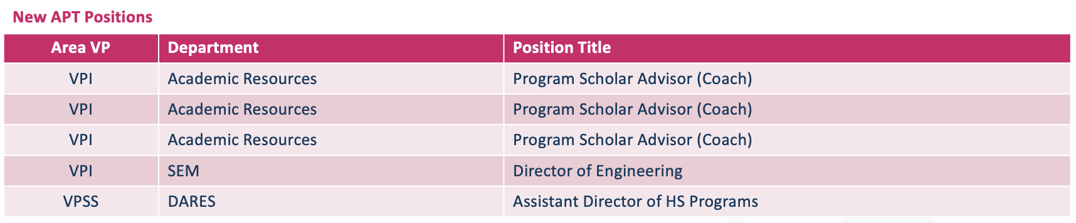
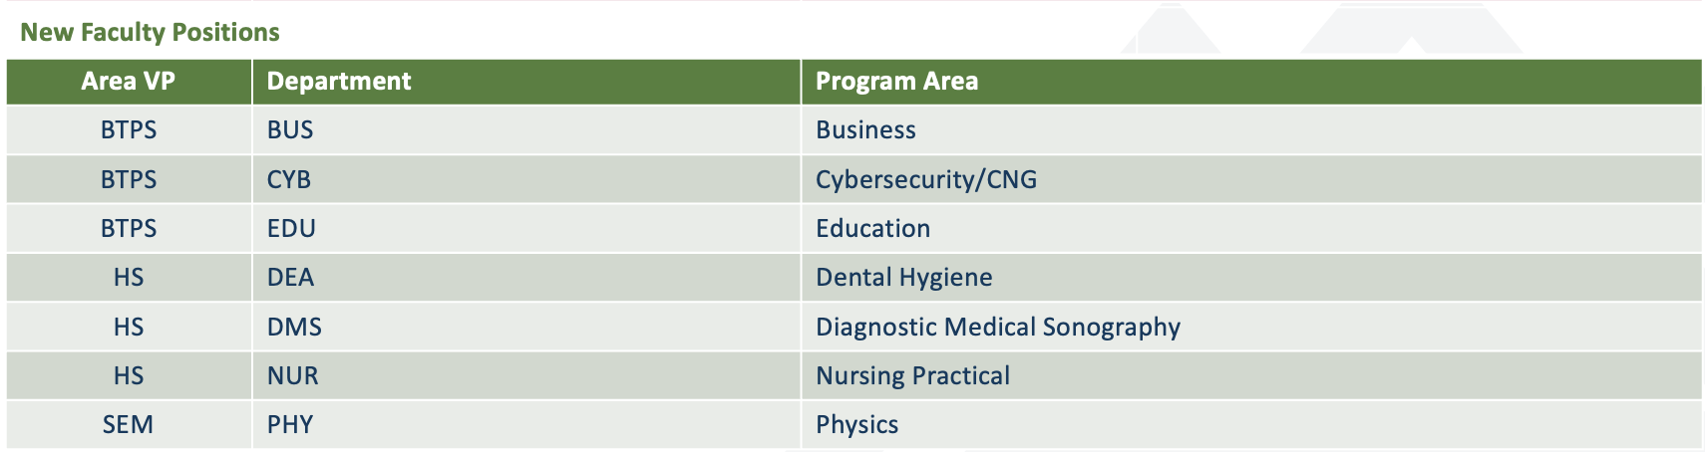
Approved Staffing Requests

Slide 21
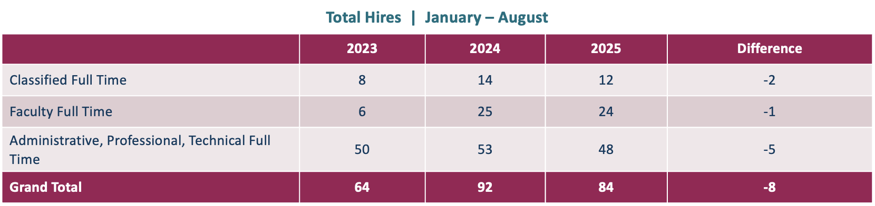
Staffing Overview
50 positions filled April to July
15 Faculty
7 Classified
28 APT
97 positions posted January to July (20 more postings pending)

Slide 22
Promise Programs

Slide 23





Enrollment & Reach
Record Enrollment: 322 new Promise students joined in 2024–2025, the highest since the program’s inception.
Persistence: 235 (73%) of these new students were
already registered for upcoming terms as of
early August 2025.
Program Scale: This semester, Promise Programs will surpass 1,000 students served since Fall 2020.
Orientation Success: All 7 Promise Welcome Orientation events reached capacity
(≈50 students each).

Slide 24

Engagement & Retention
Credit Load
Most active scholars enrolled in
12+ credits, signaling strong
course engagement.
Retention Growth
Fall-to-Fall retention increased from 47% (Fall 2020) to 74% (Fall 2023).
84% Fall 2024 to Spring 2025 retention rate for all new scholars registered Fall 2024.
Academic Standing
A majority of active scholars maintained good standing each term.
Course Success
In Spring 2025, 58% passed all attempted credits.
Continued Enrollment
Notes:
Remove Continues Enrollment

Slide 25

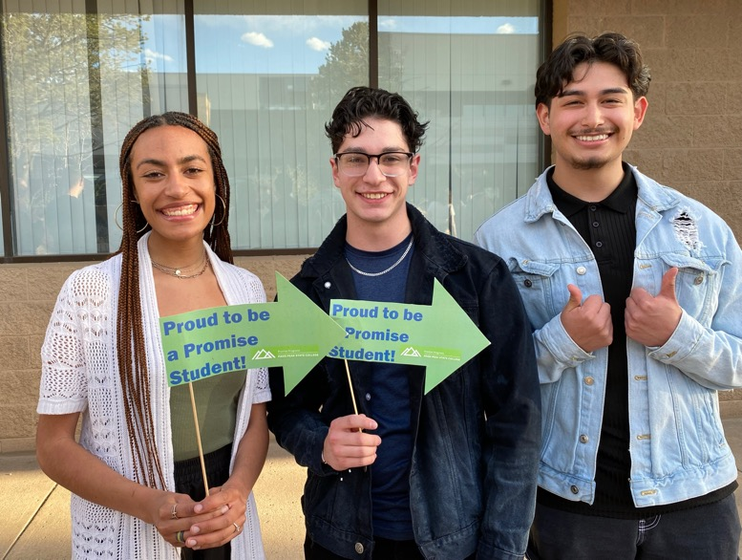
Completion & Credentials
Total Credentials Awarded: 235 credentials since the
program began.
  Degrees: 55 DWDs and 83 other Associate degrees.
  Healthcare: 26 Nursing certificates, 1 AAS Nursing degree, 6 Dental Assistants.
  Trades: 8 Welders.
Graduation Rate Growth:
  Fall 2021 cohort’s 150% rate improved to 26.5%.
  Fall 2020 cohort’s 200% rate reached 27.6%.
Transfer & Long-Term Outcomes
  Transfers: 46 scholars have transferred to other institutions after PPSC.
  Positive Outcomes: 68% of scholars experienced a positive academic outcome (graduation or transfer).

Slide 26

First Nations Promise
The First Nations Promise Program launched in
Fall 2024 with an initial cohort of 34 students.
Average Award Amounts: Over the past academic year,
11 students received a total of $45,949 in First Nations Promise Funds, which is an average of $1,392 per student.
Enrollment:
• Fall 2024 = 34 applied and approved scholars
• Spring 2025 = 48 applied and approved scholars
• Summer 2025 = 61 applied and approved scholars
• Fall 2025 = 72 applied and approved scholars
Notes:
Swap logo for photo from press conference

Slide 27

District 11 Promise
Success: Currently, twelve D11 Promise Scholars have earned a total of 16 credentials, including 4 degrees and 12 certificates.
Retention: From Fall 2023 to Fall 2024, 72% of D11 Promise Scholars returned to PPSC, compared to 50%
of all first-time students.
Enrollment: In the 2023–2024 academic year, 32 new D11 Promise Scholars enrolled at PPSC. That number grew significantly in 2024–2025, with 165 new and 23 continuing D11 Promise Scholars, for a total of 188 students participating in the program.
Notes:
How many enrolled for Fall?

Slide 28

District 2 Promise
Success: 146 D2 Scholars have earned 219 credentials (134 degrees and 85 certificates).
Retention: Fall-to-Fall retention for D2 Promise Scholars has steadily increased over the past four years, from 42% in 2020–2021 to 74% in 2023–2024. During that same period, retention for all first-time students remained relatively flat, hovering around 44–50%.
Enrollment: Since launching in 2020, the D2 Promise Program has seen steady growth. Enrollment increased from 153 students in 2020–2021 to 330 in 2024–2025, more than doubling in five years.
Notes:
How many students, graduates, enrolled, transfers, how much money we gave out

Slide 29
Instructional Services

Slide 30

General Updates
Passed HLC Comprehensive Evaluation Visit:
  At its July 1 meeting, the HLC Institutional Actions Council (IAC) reaffirmed the accreditation of
  Pikes Peak State College with the next Reaffirmation of Accreditation in 2034–35.
BoodleBox AI:
  1 Year Boodlebox Subscription.
    In-person training the week of Sept. 22–26th.
Behavioral Health:
  Moved to the Health Sciences Division
Early College Health High School
Established Division of Online Learning
Notes:
Add Online Learning to this list

Slide 31


High School Programs
Jessica McAllister
Senior Director, High School Programs
Brings 20+ years of K–12 education experience, with leadership in virtual, blended, work-based, and career-focused learning
Former Director of Innovative Programs at Lewis-Palmer School District, where she developed custom pathways for college, career, military, and life readiness
Active in statewide education initiatives, serving on boards including Minga Education Group and Colorado Digital Learning Solutions
Notes:
Jessica’s Headshot

Slide 32

New & Upcoming Programs
Enrolling Now:
BAS Business Administration
BAS Behavioral Health
Aerospace Engineering AES
Civil Engineering AES
General Engineering AES
Industrial Engineering AES
Mechatronics AES
Music Audio Technology AAS
Practical Nursing Certificate
Upcoming:
BAS Elementary Education – Waiting for HLC approval.
  Target start Fall 2026.
Diagnostic Medical Sonography
  Target start Fall 2026.
Notes:
Enrolling Now and Upcoming no Pathway Breakdown

Slide 33
Student Experience & Equity

Slide 34



Single Stop
Supporting Participants:
659 participants assisted in
the 24/25 Academic Year
3,227 referrals made to
on-campus and community resources
Tackling Food Insecurity:
41,776 Students, Faculty &
Staff accessed Community Table/Cupboards across
PPSC campuses
3,258 visits to the Mobile Food Market
Maximizing Financial Assistance:
Over $12.3 million in benefit
assistance identified as of
June 30, 2025

Slide 35

System Updates
Strategic Plan
Chancellor Search

Slide 36
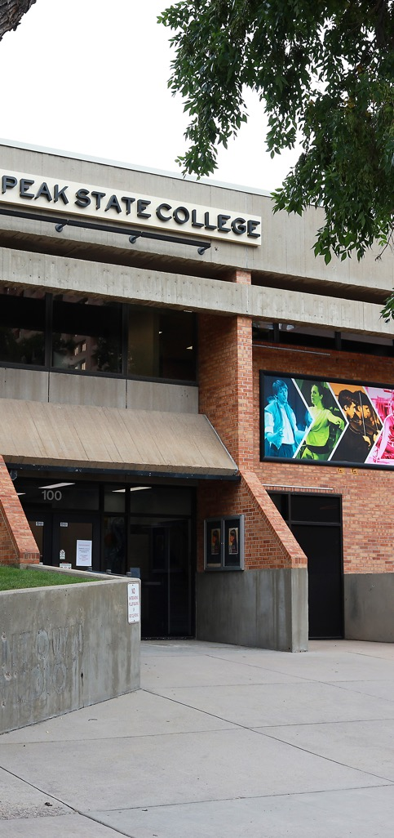
2024–26 Focus Goals First Year Highlights
Hispanic Serving Institution
Achieved HSI Status
Hired first HSI Coordinator, David Lopez
Formed HSI Taskforce
Hosted Hispanic Heritage Festival and will host Fiestas Patrias
Invited to join the The Steve Fund
Downtown Campus Revitalization
Increased Enrollment by 12.2%
Hired first Engagement and Events Manager, Rotimi Ariyo
Hosted 68 community events and 20 internal events
Completed numerous safety, functional and cosmetic Improvements
Welcomed new programs: BEH AAS and BAS, & Teacher Partnership with D11

Slide 37

2025–27 Focus Goals
Onboarding & Professional Development Working Groups:
Onboarding will understand the colleges current practices,
then build a consistent onboarding procedure for the college.
Professional development group will study existing PD opportunities such as trainings, mentoring, etc.
Retention
This group will build retention goals and metrics while also identifying foundational resources, supports and communication tactics.
Workforce Development

Slide 38
Facilities & Operations

Slide 39

Facilities Master Plan
In Partnership with Steinberg Hart
Strategic Priorities
Improving student success and retention, especially for first‑semester students.
Responding to evolving workforce and industry needs.
Creating welcoming, accessible, and inclusive campuses.
Supporting our employees with environments that energize and empower.
Engagement and Next Steps
We’ll be engaging students, faculty, staff, and community partners through surveys, forums, and campus‑level discussions.
Our immediate next steps include data collection and visioning sessions at each campus.
Your input is essential to make sure the plan reflects the real needs of our community.
More information is coming within the next few weeks.

Slide 40
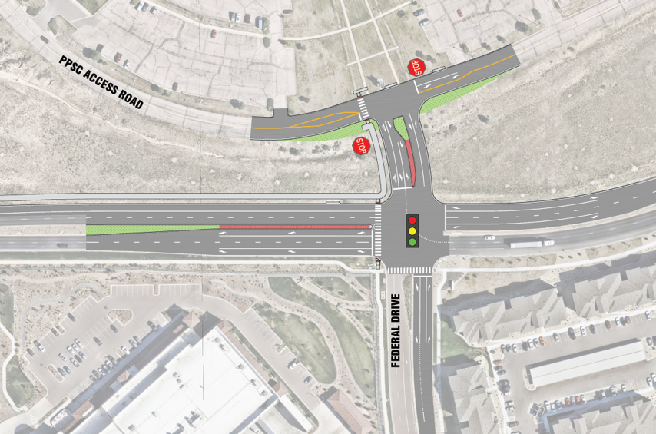
Rampart Transportation Improvements
Working with Mountain Metro and City Traffic Engineering Team for these improvements:
  creating a public transit mobility hub at Rampart Range Campus
  bus service between Rampart and CHES
  bus service between all of our campuses
  construction of the new intersection to facilitate easier entrance/exit to Rampart Range Campus from Interquest Pkwy.
  Town Hall at Rampart October 22.
Notes:
Road Improvement Map

Slide 41
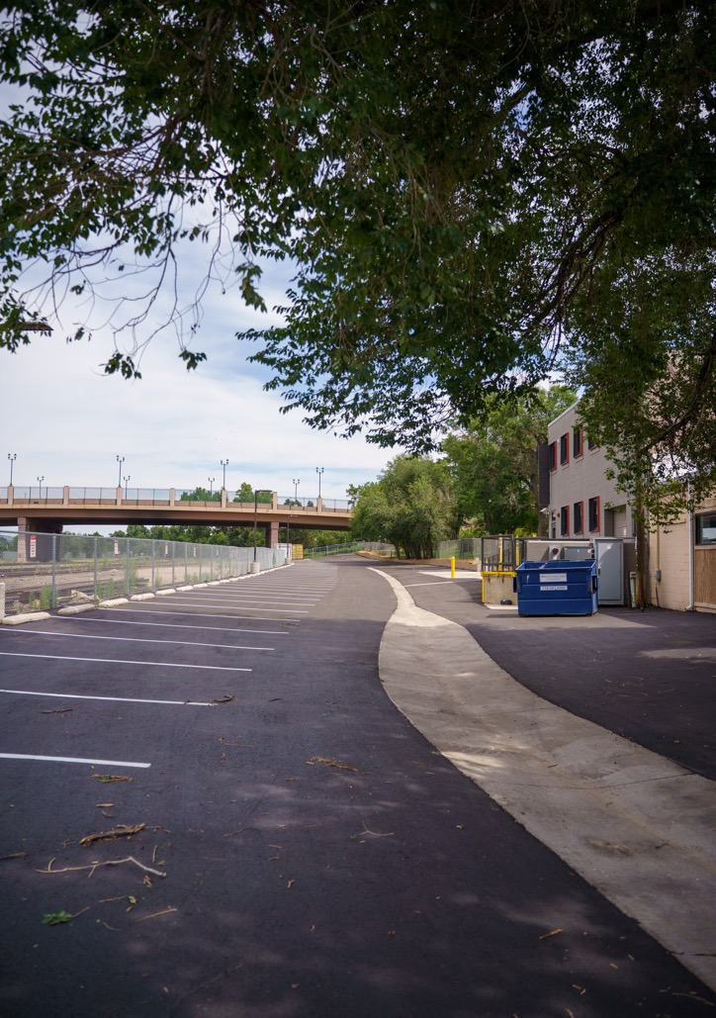
Other Improvements
Paving
The work is weather dependent and can only occur during the warmer months.
The type of work depends on the severity of the damage, and
can range from crack sealing and patching to full reconstruction
of the pavement.
PPSC’s 2025 paving projects include:
  Parking lot behind Studio West - COMPLETE
  Upper C Lot at Centennial
  Service Road improvements at Centennial
  Between the stair wells on the north side of Centennial,
  near the drop-off area
2026 paving project will focus on Rampart Range Campus
parking lots.
Notes:
Finished Studio West Parking Lot

Slide 42
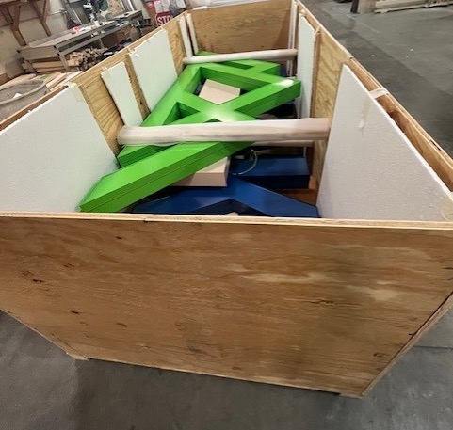
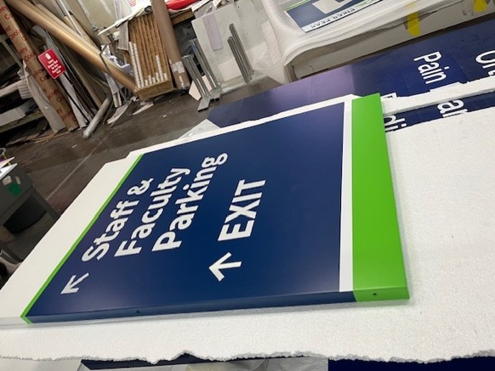
Wayfinding
Phase 1 Interior & Exterior Installation finishes this fall.
Phase 2 We'll send out a request form for additional signs this fall.
Notes:
Actual photos of the Channel Letters

Slide 43

Kudos

Slide 44


Kudos – page 1
For our outstanding commitment to fostering emotional wellness and belonging across campus, PPSC has been recognized by Insight Into Academia with:
  2025 Higher Education Excellence and Distinction (HEED) Award
  2025 Excellence in Mental Health and Well-being Award
PPSC has again earned the Gold designation in Military Times’ 2024
“Best for Vets: Colleges” rankings, recognizing the college as a national leader in serving military-affiliated students. This distinction reflects
PPSC’s strong commitment to veteran support, student success, and dedicated military resources.

Slide 45
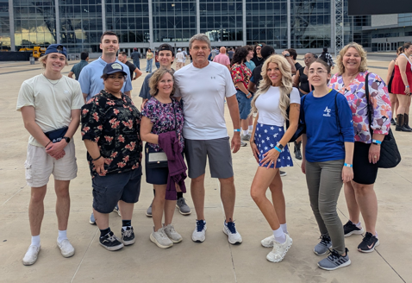
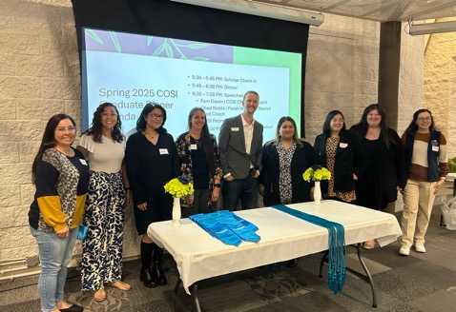
Kudos – page 2
PPSC FBLA National Competition
  Seven students and two advisors represented PPSC at the FBLA National Leadership Conference from May 30 to June 3 in Dallas, Texas: Amanda Darnell, Michelle Harris, Nick Jacobs, Natasha Polombo, Finn Russom, Dawson Rowbotham, and Jesper Sandeen, with Advisors Clint Schaffer and
  Carol Kurkowski.
    Finn Russom became the National Champion with a first-place finish in the International Business objective test and placed 4th in Foundations of Technology.
The COSI: Community Partners Program (CPP) and COSI: Finish What You Started (FWYS) programs partnered on April 25th to host a COSI Graduate Dinner.
  COSI CPP celebrated 88 scholars completing 109 degrees or certificates.
  The FWYS program celebrated 43 scholars completing 54 PPSC degrees or certificates.
Congratulations to the Alpha Gamma Alpha Honors in Action team. Their Honors in Action Hallmark Award entry, “Preserving Stories Through Poetry: A Celebration of Voices and Heritage” was selected from among 416 entries to be included as one of 15 articles in the 2025 edition of Civic Scholar: Phi Theta Kappa Journal of Undergraduate Research.
FBLA National Competition
COSI Graduate Dinner

Slide 46
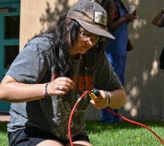

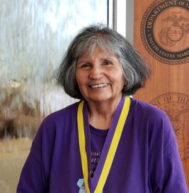
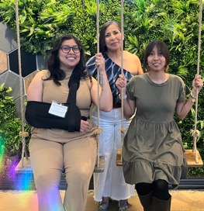
Kudos – page 3
Sami Koller: A geology major who began her academic path at Pikes Peak State College, Sami overcame self-doubt to transfer to her dream school, Colorado College, earning honors such as Dean’s and President’s Lists and Phi Theta Kappa membership, proving that community college can be a powerful launchpad for success.
Yemi Andrade Cervantes: Graduating with her Associate of Arts in Psychology in Spring 2025, she has excelled as a Student Ambassador, Vice President of Phi Theta Kappa, and Regional PTK President, while pursuing her bachelor’s in behavioral health and serving full-time in Enrollment Services, where she supports Spanish-speaking students with leadership, compassion, and dedication.
Cynthia Beuttel: After nearly 50 years of perseverance through hardship, single parenting, and life interruptions, Cynthia fulfilled her long-held dream by graduating from Pikes Peak State College in May 2025, proving it’s never too late to achieve
your goals.
Araceli Delgado: The president of the Latino Alliance, she was honored as an Inclusive Excellence Champion at the 2025 CCCS Student Excellence Awards for her leadership in the Hispanic Heritage Festival and her ongoing work with the Student Experience Inclusion and Empowerment team to build a more inclusive campus community.
Sami Koller
Yemi Andrade Cervantes
Cynthia Beuttel
Araceli Delgado

Slide 47
Questions?

